Slide 1
Jemmy Testing Toolkit
Mario Aquino (mario@ociweb.com)
Object Computing, Inc.

Slide 2
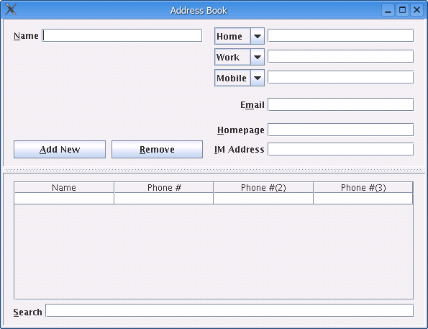
A Simple Demo…

Slide 3
Testing
All tests should:
  Run automatically (without human assistance, intervention, or participation)
  Have a pass/fail result
  Should be able to be repeatedly run and provide consistent and indisputable results

Slide 4
Testing Approaches & Scopes
Unit test(ing) should:
  Focus on the contract of a single unit API (usually a class)
  Not have external dependencies - should run in isolation
  Run quickly, quietly, and all the time

Slide 5
Approaches & Scopes (cont.)
Integration test(ing) should:
  Focus on specific system-supported functionality
  Test externally observable application behaviors
  Exercise many aspects of a system at a time
    System components working together to provide a capability
  Take longer to run and have a much broader scope than unit tests
  Have a different run frequency: nightly, weekly, or as a release is approaching

Slide 6
Approaches & Scopes (cont.)
Others:
  Performance testing
  Security testing
  Acceptance testing
  ... (beyond the scope of this presentation)

Slide 7
Jemmy
Free, open source testing toolkit for Swing/JFC applications
Supported by the developers of the NetBeans IDE
http://jemmy.netbeans.org

Slide 8
An Operator for Everything
Operator classes provide interface to AWT & Swing components and containers:
  JButtonOperator, JCheckBoxOperator, JColorChooserOperator,
  JComboBoxOperator, JFileChooserOperator, JFrameOperator,
  JInternalFrameOperator, JLabelOperator, JListOperator,
  JMenuBarOperator, JMenuItemOperator, JPopupMenuOperator,
  JProgressBarOperator, JScrollBarOperator,
  JScrollPaneOperator, JSliderOperator, JSpinnerOperator,
  JSplitPaneOperator, JTabbedPaneOperator,
  JTableHeaderOperator, JTableOperator,
  JTextComponentOperator, JTextFieldOperator, JTreeOperator
  … and many others

Slide 9
Using Operators
Operators can find, read, and interact with components
Finding components can be done several ways
  By component name
  By tooltip
  By order within a container
  Roll your own finding strategy
Once found, component behaviors can be exercised by their corresponding operator

Slide 10
Decomposing a Test
Test sequence
  Start your application by calling its main class
  Find the main frame/window of your application
    Everything in your app lives under this high-level container
  Find a component somewhere inside the frame (menu, textfield, combo box, table, etc.)
  Use it or read its value (and make assertions)
  Rinse and repeat…

Slide 11
Finding a Component
Components can be found quickly or patiently
  Static finder methods on Operator classes (quickly)
    Find the component and return a reference to it or return null immediately
  Operator class constructors (patiently)
    Block until a timeout, waiting to find the component you are looking for

Slide 12
Finding a Component (cont)
ComponentChooser interface used in finding components
  Determines whether a particular component is the one you are looking for
  boolean checkComponent(java.awt.Component comp);
  You can extend existing ones or create new custom choosers

Slide 13
Queue Tool
Jemmy API provides a pausing mechanism
  QueueTool pauses execution thread until the event queue has been empty for variable period of time
  Pausing is useful because it allows the UI to catch-up to where a test is trying to get

Slide 14
Testing Images
Forms that display dynamic (generated) images can be tested using comparison tools
  A displayed image (or portion therein) can be found (via rough or strict image finders)
    RoughImageFinder & StrictImageFinder
  Once found, the image can be compared (strictly or roughly) to a file image
    RoughImageComparator & StrictImageComparator
  Image produced during test can be stored to PNG for later visual inspection (if desired)
    org.netbeans.jemmy.image.PNGImageLoader
    org.netbeans.jemmy.image.PNGImageSaver

Slide 15
Scenario & Test
The org.netbeans.jemmy.Scenario interface provides the actual test
  int runIt(Object o);
  Integration testing activity is defined within runIt() method
The org.netbeans.jemmy.Test class executes a Scenario
  assertEquals(0, new Test(scenario).startTest(null));

Slide 16
Jemmy & JUnit
The Jemmy API does not provide for assertive evaluation
This makes integrating Jemmy tests with JUnit a natural fit
  The Jemmy APIs find Swing/AWT components on a form
  The JUnit APIs perform the expected vs. actual value comparison (assertion)

Slide 17
Jemmy & JUnit (cont.)
Integrating Jemmy & JUnit gives you:
  The facility to run Jemmy tests where ever you can run JUnit tests
    From your IDE
    From Ant or Maven
  Jemmy integration tests can now be part of your continuous integration process
    Your CruiseControl (build automation) process can now include regular execution of your integration tests

Slide 18
Testing the Simple Demo
A test for adding and removing contacts
A test for selecting contacts in the table
A test for searching for contacts
A test for sorting the contact table

Slide 19
Testing the “Interface”
Jemmy tests should focus on the interface rather than the implementation
  Input fields on a form are equivalent to method parameters
  Data output on the form is the return value
  Inputs, outputs, behaviors, and side-effects are the contract of the form
    Just as with unit tests, focus on contract over implementation

Slide 20
Testing the “Interface” (cont.)
Encourages UI design with consistent patterns:
  All inputs and outputs have tooltips that are:
    Immutable
    Unique
    Consistent
    Initialized with the form
  Type-safe enumerations are convenient for consolidating field metadata
  Following these principles, tests are unaffected by rearranging the location of form inputs and outputs.

Slide 21
Jemmy in a TDD Context
A typical TDD approach at the unit level:
  Create a skeleton interface (but no implementation)
  Write tests for the contract of interface
  Run the tests to see that they fail
  Start writing an implementation to fulfill the contract and pass the tests

Slide 22
Jemmy & TDD (cont.)
A similar approach works for Jemmy testing as well:
  Create a skeleton form with all the UI components
  Write a Jemmy test to exercise functionality the form should provide
  Run the test to confirm that it fails
  Connect the components on the form to functionality-providing application logic

Slide 23
Jemmy Quirkiness
Lots of output (if you don’t turn it off)
  JemmyProperties class controls where messages get sent during test execution
  By default, Jemmy is verbose ☹
    Tests should run quietly and only speak up when something is wrong!
  JemmyProperties.setCurrentOutput() allows you to redirect message output

Slide 24
Jemmy Quirkiness (cont.)
Exception thrown even when tests succeeds
  TestCompletedException thrown after test finishes to signal successful completion
org.netbeans.jemmy.TestCompletedException: Test passed
at org.netbeans.jemmy.Test.closeDown(Test.java:126)
at org.netbeans.jemmy.Test.launch(Test.java:353)
at org.netbeans.jemmy.ActionProducer.launchAction(ActionProducer.java:312)
at org.netbeans.jemmy.ActionProducer.run(ActionProducer.java:269)

Slide 25
Jemmy Caveats
Jemmy only supports JFC widgets
  Custom widgets need to have custom operators designed for them
    Widgets that extend JComponent and provide functionality not readily available in JFC widgets
The Jemmy library doesn’t have an obvious version stamp
  Unfortunately, you need to check the website periodically for updates
  You can look inside the Jemmy jar at a “version_info” file

Slide 26
Questions?
Questions?
  Questions?
    Questions?

